Slide 1
NOVIS Insurance Company Inc.

Slide 2
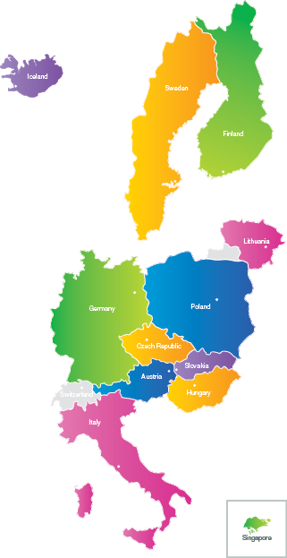
NOVIS is an exceptional Insurance Company with a large number of real innovations and with clients in ten European countries. In 2017 the company started very successfully in Italy and it the beginning of 2018 it has launched its operations in Sweden and Iceland.
NOVIS is providing its services also for professionals who work outside of their home country (expatriates) and thus becomes a globally active insurance company.

Slide 3
HISTORY
"Jadranka" first client in Austria
Start of global activities (insurance for expatriates)
2016
NOVIS was established
2012
"Tibor" first client in Hungary
2014
"Gunnar" first client in Iceland
2018
2013
NOVIS received a license from the National Bank of Slovakia
"Siegfried" first client in Slovakia
2015
"Ivo" first client in Czech Republic
"Annette" first client in Germany
2017
First client in Finland
"Mirosław" first client in Poland
"Lukas" first client in Italy

Slide 4
VISION
The vision of the NOVIS Insurance Company was to bring something that surpasses stereotypical insurance products and duplicates the needs of modern people.
NOVIS was established by the 15 shareholders from 6 countries. It has its headquarters in Bratislava.
Among the founders were 5 Managing Directors from different industries and countries, as well as members of the Board of Directors of insurance companies and banks.
In the first two years of its operation, it has become a profitable company and its outstanding product has been traded in the world of insurance.

Slide 5
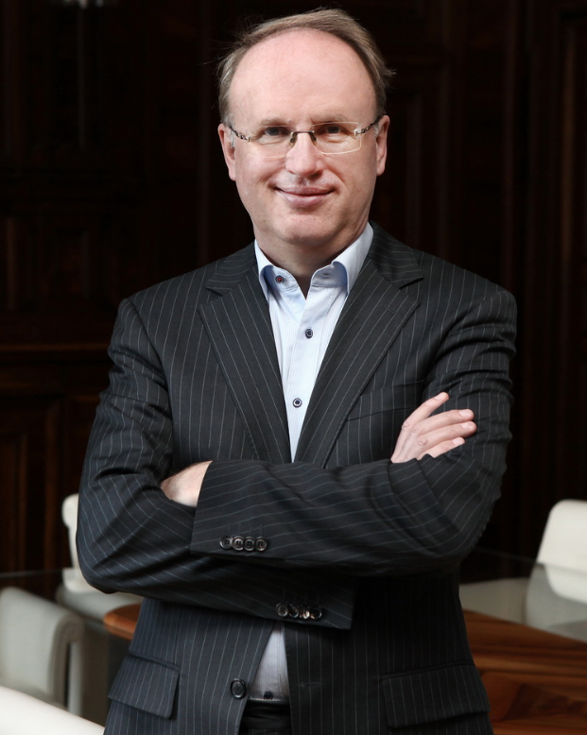
SIEGFRIED FATZI
Author of the universal insurance product Founder, CEO and Chairman of the Board
Founded the first insurance company already at the age of 33 years.
Experiences from 7 insurance companies in 6 countries.

Slide 6
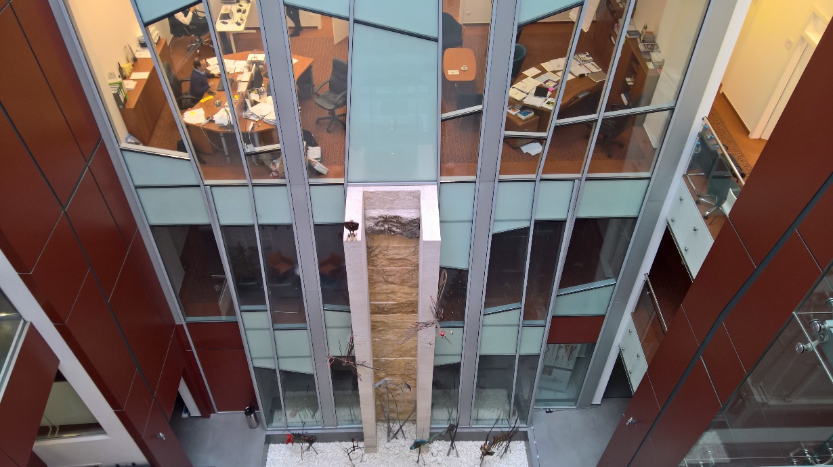
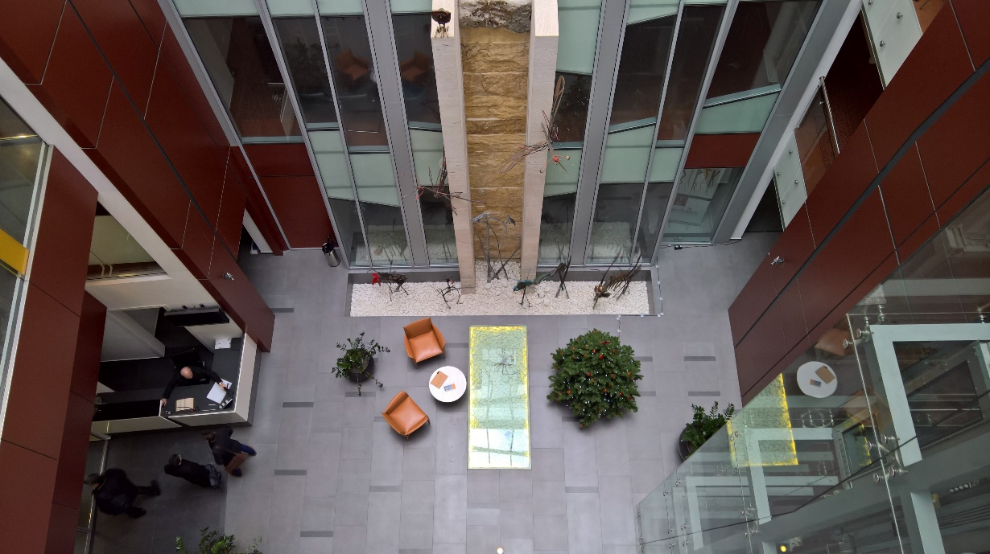
HEADQUATERS
NÁMESTIE ĽUDOVÍTA ŠTÚRA 2, 811 02 BRATISLAVA SLOVAKIA

Slide 7
RESULTS
Gross Premium Earned
Profit
Solvency II regulatory regime

Slide 8
GROSS PREMIUM EARNED (in thousand Euro)
24 043
12 842
6 972

Slide 9
PROFIT (in thousand Euro)
7 449
3 682
2 813
1 206

Slide 10
Solvency II regulatory regime
NOVIS manages capital to ensure solvency financial stability. According to the legislation in place, solvency of an insurance company is understood as the ability to permanently secure, with own resources, defined as Eligible Own Funds (EOF), the coverage of all liabilities arising from insurance contracts, so called Solvency Capital Requirement (SCR). Based on information provided internally to key management personnel and officially published by the Company, the SCR ratio was 135% and Minimum Capital Requirement - MCR Ratio was 539% as of 31. December 2017.
131%
485%
154%
615%
135%
539%

Slide 11
SALES STRATEGY

Slide 12
INDEPENDENCE
NOVIS assists potential customers to compare its products with other available insurance products. However, a fair comparison is not possible when a company employs its own network of dependent agents. Those agents can only offer products of their own insurance company.
NOVIS Insurance Company has made the strategic decision to offer its products exclusively through independent financial intermediaries. NOVIS brokers may offer NOVIS products and those of its competitors.
NOVIS is confident that once its potential customers have obtained independent advice, they will become satisfied customers.

Slide 13
THANK YOU FOR YOUR ATTENTION
NOVIS Insurance Company Inc.
NOVIS Poisťovňa a.s.
Námestie Ľudovíta Štúra 2
811 02 Bratislava
SLOVAKIA
www.novis.eu
novis@novis.eu
The information provided in this presentation does not in any way constitute legal, accounting, tax or other professional advice by NOVIS Poisťovňa a.s. This presentation may contain information obtained or derived from a variety of sources. NOVIS Poisťovňa a.s. has not sought to establish the reliability of all of those sources of information or otherwise verified the information so provided, although NOVIS Poisťovňa a.s. has endeavored to include in this presentation the information it believes to be reliable, complete and up-to-date.
Accordingly no representation or warranty of any kind (whether express or implied) is given by NOVIS Poisťovňa a.s. to any person as to the accuracy or completeness of such information. Therefore, NOVIS Poisťovňa a.s. in no case whatsoever will be liable to anyone for any decision made or action taken in relation with the information used in this presentation or for any related damages or any potential disputes that could arise from sharing this presentation or the information with any third party.

